Slide 1
Graph Random Neural Networks for Semi-Supervised Learning on Graphs
NeurIPS_2020
https://github.com/THUDM/GRAND
2021.01.07 • ChongQing
Reported by Chenghong Li

Slide 2
1. Introduction
2. Method
3. Experiments
4. Conclusion

Slide 3
Introduction
The graph convolution operation is a special form of Laplacian smoothing and consequently, stacking many GNN layers tends to make nodes’ features indistinguishable.
The deterministic propagation makes each node highly dependent with its neighborhoods, leaving the nodes to be easily misguided by potential data noise and susceptible to adversarial perturbations.
We propose random propagation in GRAND, wherein each node’s features can be randomly dropped either partially or entirely, after which the perturbed feature matrix is propagated over the graph.
As a result, each node can be insensitive to a particular neighborhood, increasing the robustness of the GRAND and reducing the risk of over-smoothing.

Slide 4
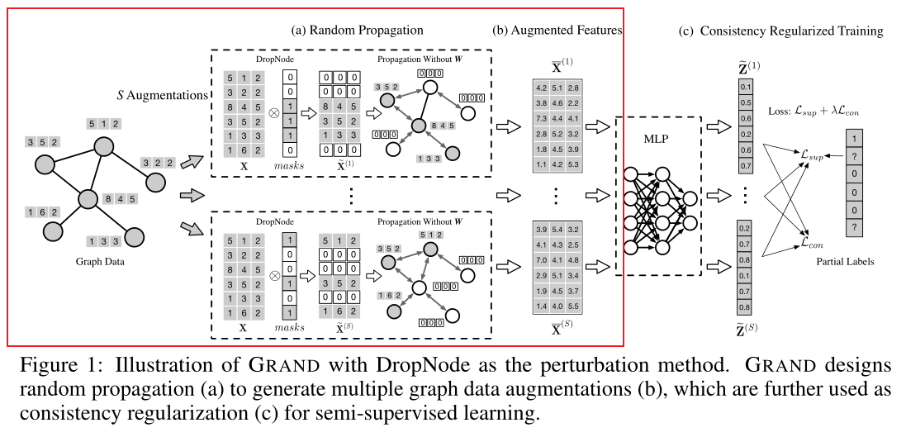
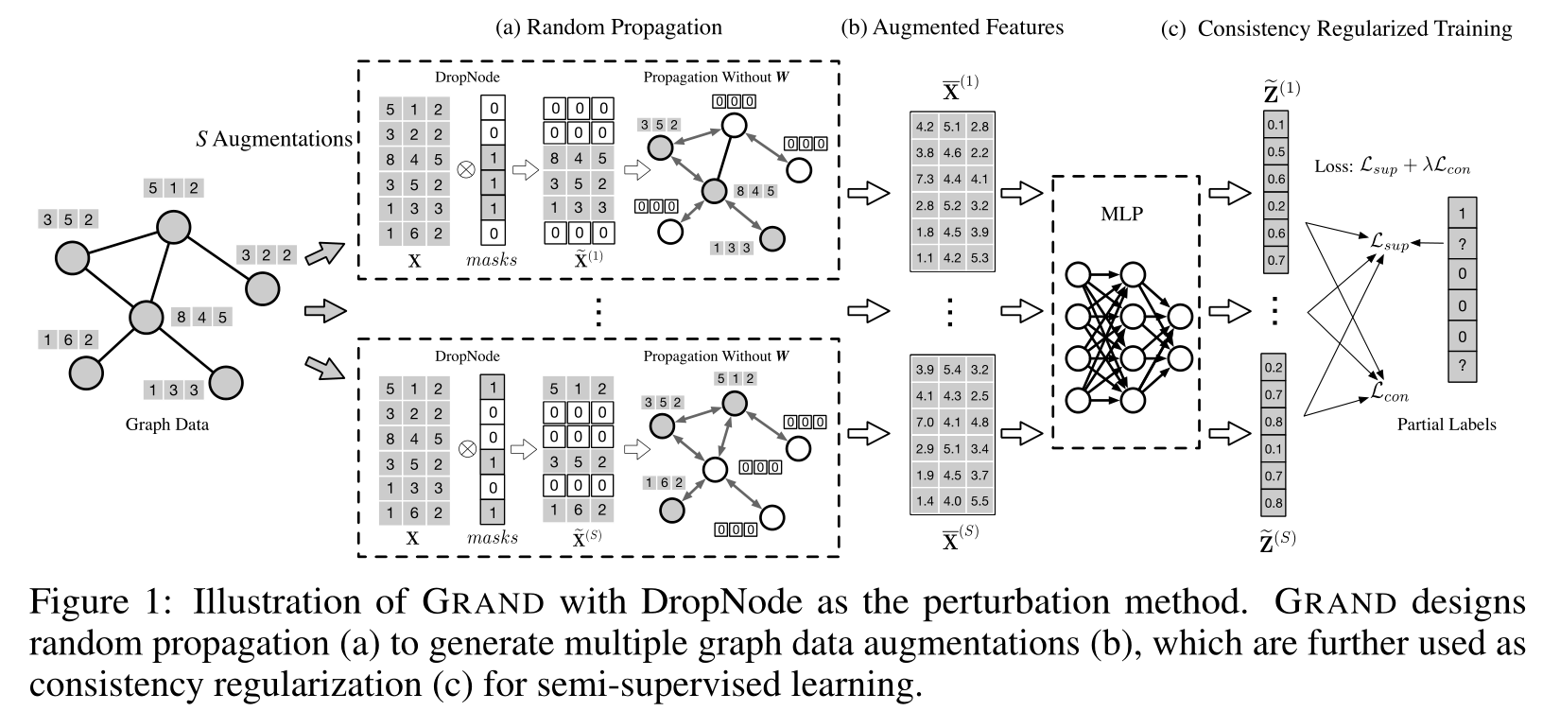
Method
(a)
(b)

Slide 5
Method

Slide 6
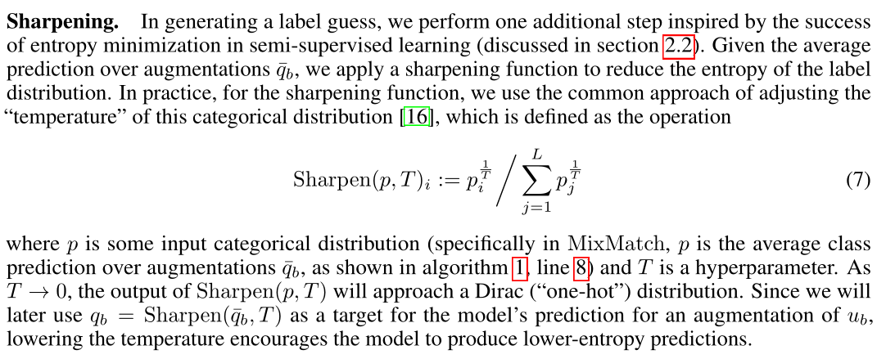
Method
NeurIPS_2019_MixMatch_A Holistic Approach to Semi-Supervised Learning

Slide 7
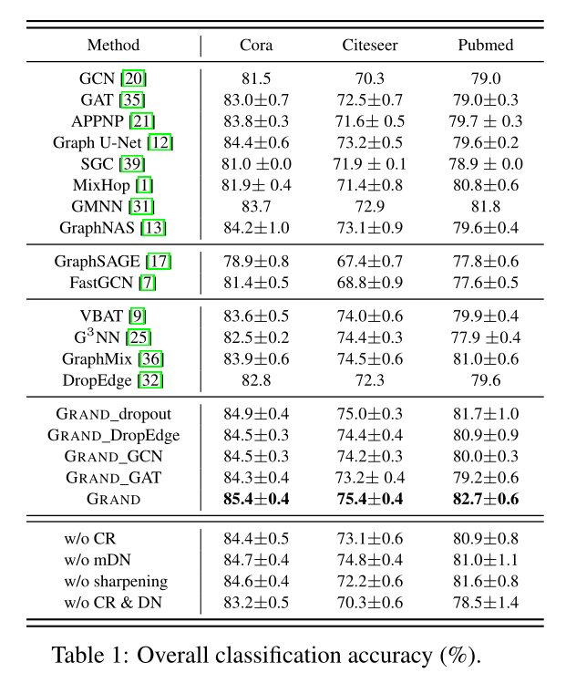
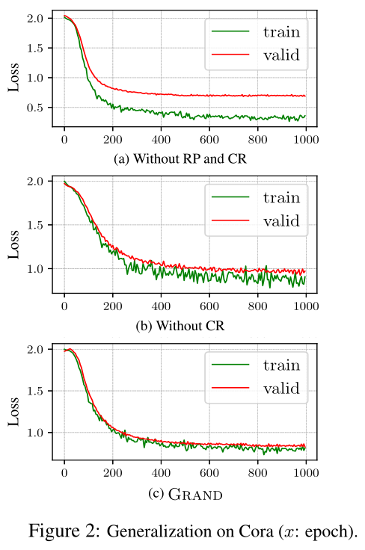
Experiments

Slide 8
Experiments

Slide 9
Conclusion
We propose the random propagation strategy to stochastically generate multiple graph data augmentations, based on which we utilize consistency regularization to improve the model’s generalization on unlabeled data.

